Slide 1

INTERNSHIP TASK:
CLASSIFICATION ON “ROAD TRAFFIC ACCIDENT DATA”
Presented By
Laiba Memon

Slide 2
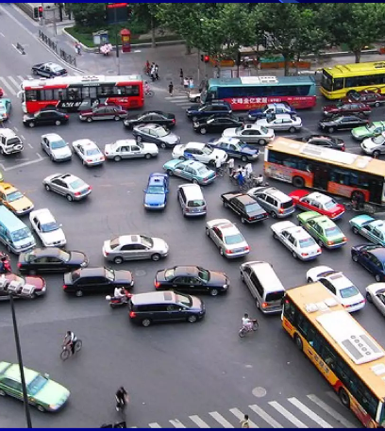
INTRODUCTION
Road Traffic Accidents (RTAs) indiscriminately rock the world with thousands of deaths and property destruction in a single day, but little attention has been paid to mitigate their severity. However, it is one of the world's most life-threatening incidents, resulting in death and property damage. Identifying the main drivers of traffic accidents can help provide appropriate solutions to minimize the negative impact of severity on personal injury and property damage. Road severity is not random: there are
patterns that can be predicted and avoided. Accidents are “events that can be investigated and analyzed”,

Slide 3


PROBLEMS!
Over-speeding, rash driving.
Failure to understand sign

Slide 4


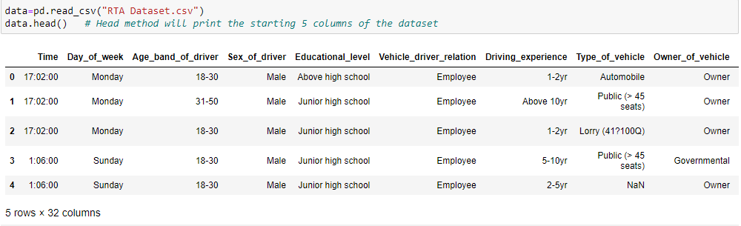
DATASET OF ROAD TRAFFIC ACCIDENT

Slide 5
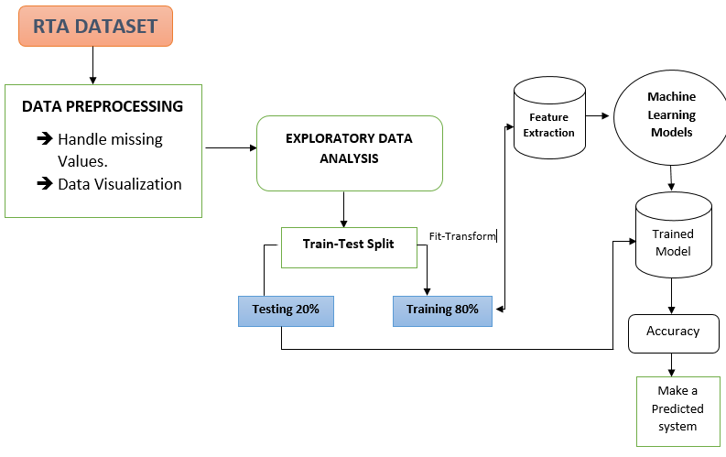
METHODOLOGY/WORKFLOW OF PROJECT

Slide 6
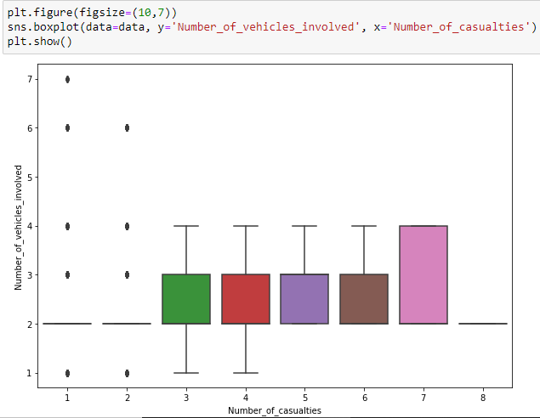
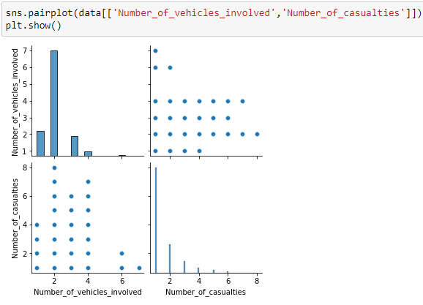
Data Visualization
Fig 1
Fig 2

Slide 7
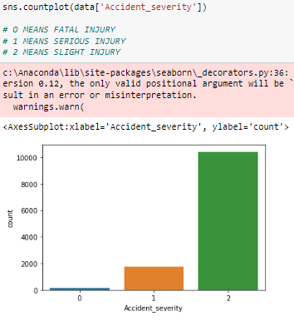
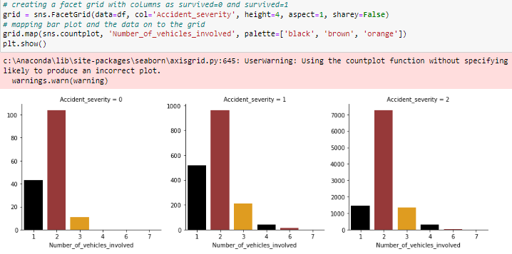
Fig 4:
Fig 3:

Slide 8
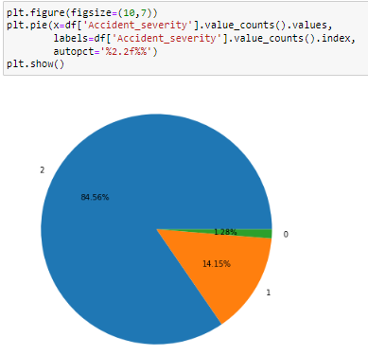
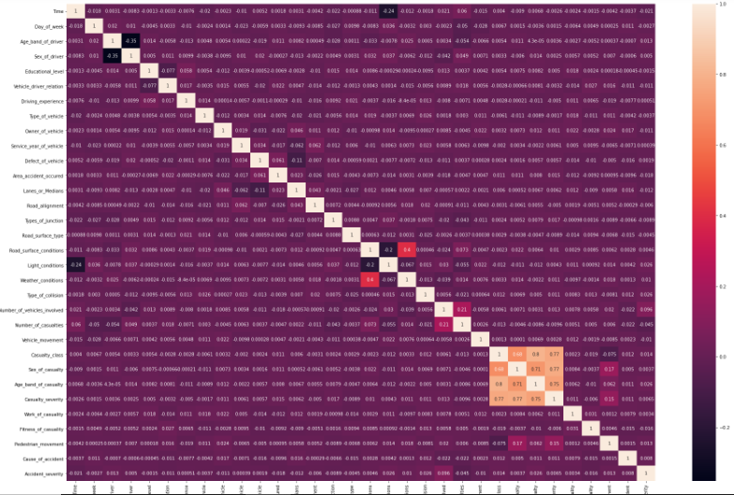
Heatmap to find the correlation between columns

Slide 9
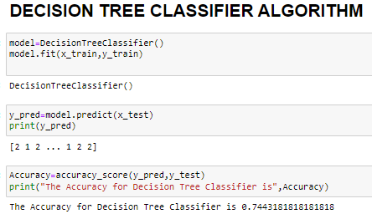
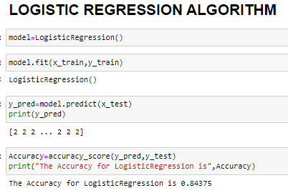
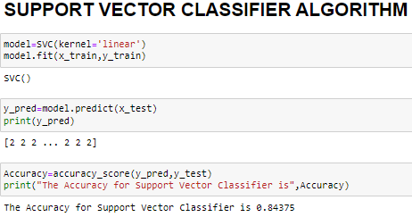
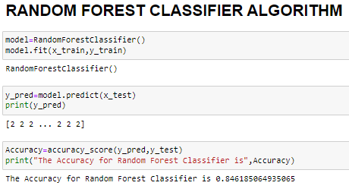
APPLING DIFFERENT MACHINE LEARNING ALGORITHMS

Slide 10
CONCLUSION
By understanding the major and contributing factors of traffic accident severity, I have developed a model to predict severity in the RTA dataset, and further developed insights into traffic accident severity and key target-specific. I have identified the factor. Get the most important traffic accident variables. After applying several algorithms such as random forest, logistic regression, and SVM for severity prediction classification, the proposed approach has 84% ​​accuracy among the classification methods as compared with other classification methods. I understand. Target-specific model interpretation results showed that driver experience, vehicle type, and vehicle motion significantly contributed to the severity of fatal, serious, and minor injuries, respectively.

Slide 11

THE END

